Slide 1
PROPOSALS
CHAPTER: 10

Slide 2
Think of a time when you had a successful sales experience. Perhaps you persuaded a person or a group to buy a product or service or to agree to an idea such as a fund-raiser or a community or family project.
Write a narrative about that experience. Include ways in which you prepared to make the sale as well as a description of your audience.

Slide 3
A PROPOSAL is a persuasive document that offers a solution to an identified
problem or need.
Proposals are written to convince your readers to adopt an idea, a product or a service.
This can be directed to:
colleagues inside your own organization (in-house proposals),
to clients outside your organization (sales proposals),
to organizations that fund research and other activities (grant proposals) .
In all three cases, proposals can be presented either as a:
short simple format (informal reports)
a longer, more complicated format (formal proposal)
Proposals can be either:
Requested by the reader(solicited)
Submitted without a request (unsolicited)

Slide 4
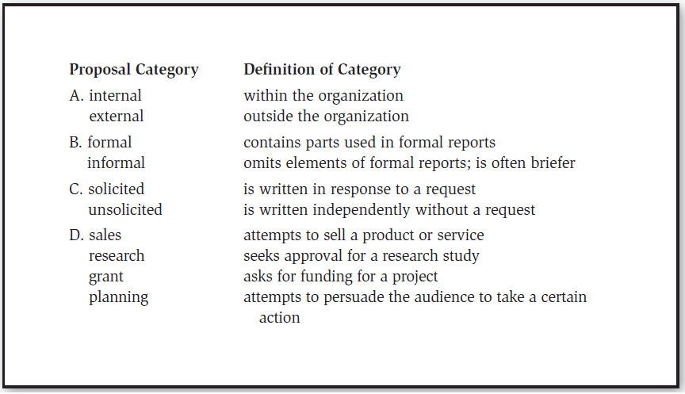
Proposals can be categorized in several ways relating to the audience:

Slide 7
In-house proposal for security protocol training: | James Oliver, Chief Financial Officer, has received the results of an internal audit that found problems in the way client information is being digitally secured. He asks Greg Bass, Director of Information Systems (IS), to propose changes that will improve IS security and training of all affected employees.
In-house proposal for change in purchasing practices: | Mack Boh, Facilities Maintenance Supervisor at the Baltimore branch office, writes a proposal to Brenda Seymour, Purchasing Director, suggesting that M-Global use environmentally friendly cleaning products whenever possible. The proposal describes a system for trials of products for effectiveness; each branch will use the system to develop its own list of approved products.

Slide 8
Sales proposal for dam removal project: | The Minnesota Department of Natural Resources issues a Request for Proposals for the removal of an earthen dam from a state park. The dam, built in the 1930s, is no longer safe, and it is to be removed as the first step in a river restoration project.
Grant proposal for new equipment design: | Oilarus, Ltd., a British oil company, sometimes gives research-and-development funds to small companies. Such funding usually goes toward development of new technology or products in the field of petroleum engineering. Angela Issam, who works in M-Global’s Equipment Design Lab decides to apply for funding for a research project. Her proposed project, if successful, would provide a new piece of oil-drilling safety equipment that would reduce the chance of offshore oil spills at production sites.

Slide 9
Some basic guidelines apply to all proposals, regardless of their audience or format
1. Plan Well Before You Write - surveying the current situation, identify the best way to improve the current situation, conduct research, develop a plan
2. Make Text Visually Appealing - Remember—you are
trying to sell a product, a service, or an idea.
■ Use lists (with bullets or numbered points) to highlight main ideas.
■ Follow your readers’ preferences in font size, type, line spacing, and so forth. Proposals written in the preferred format of the reader gain a competitive edge.
■ Use headings and subheadings to break up blocks of text.
3. Edit Carefully

Slide 10
A proposal is solicited or unsolicited depending on the audience’s role in its initiation.
Unsolicited proposal: A document submitted without a request to convince your readers to adopt an idea, a product, or a service. Unsolicited proposals are usually written as informal documents and often addressed to internal audiences.
Solicited proposal: A document requested by the reader to help the reader solve a problem through the purchase of a product or a service. Solicited proposals are usually written as formal documents and addressed to external audiences.
Request for proposal (RFP): A document sometimes sent out by an organization that wants to receive proposals for a product or service. The RFP gives guidelines on (1) what the proposal should cover, (2) when it should be submitted, and (3) to whom it should be sent. As writer, you should follow the RFP guidelines diligently in planning and drafting your proposal.

Slide 11
Notes:
Establishing need is crucial in unsolicited proposals, of course, when readers may not be psychologically prepared to accept a change that costs them money.

Slide 13
RFP
Flowchart showing the main documents involved in one possible project
PROPOSAL
FEASIBILTY
STUDY
Feasibility studies are documents that show the practicality of a proposed policy, product, service.
RFP (request for proposals) are documents sometimes sent out by organizations that want to receive proposals for a product or service.
CONTRACT
PROJECT

Slide 14
Grant proposal: A document written to convince your readers to support a specific project that meets the needs of a social or professional community. Directed to organizations that fund research and other activities, grant proposals help granting organization meet their goals for improving communities.
These communities may be local, or they may be global. Grant proposals may seek to improve social conditions, or they may seek support for research to add to knowledge in a profession or to improve the quality of life for many people through improvements in specific bodies of knowledge.
Grant proposals are often written as formal documents in response to specific requests for proposal or standing grant programs. Some organizations, such as universities or government agencies, may also have internal programs that provide grants to improve services to constituents.

Slide 15
Notes:
Grant writing is an important process for nonprofit organizations and researchers
The grant-proposal writing process is similar to the process for writing proposals for a business purpose.

Slide 16
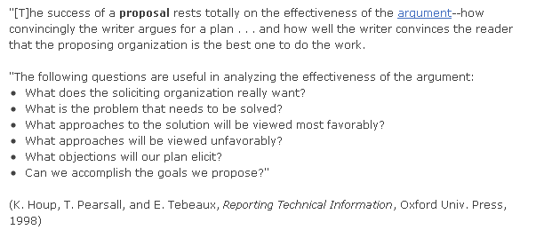

Slide 17
TASK:
Choose a problem for which you would consider proposing a solution.
Identify which type of proposal it will be.
Recreate the thinking process, for the problem discussed, by:
a. Developing a list of positive and negative aspects of the solution.
b. Creating a list showing how the solution meets the needs of the audience or solves the problem.
3. Present your ideas.

